Slide 1
STANDARD OPERATING PROCEDURE
FOR
HYDRAULIC PUMPS AND MOTORS

Slide 2
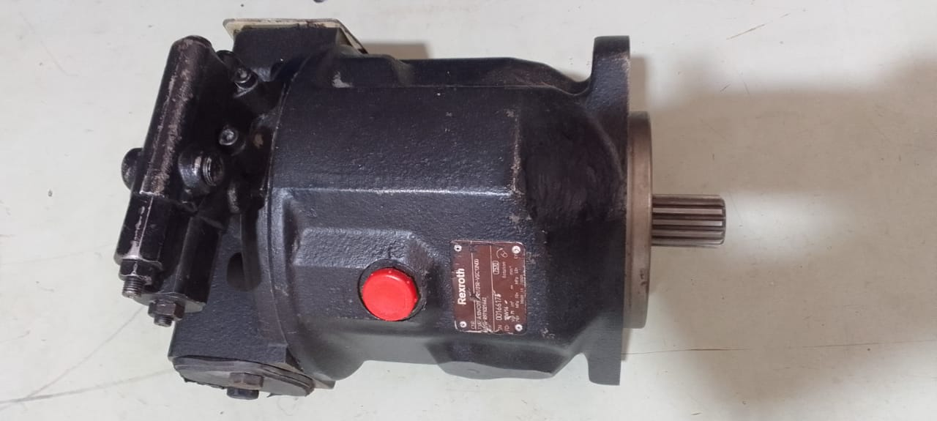
MODEL ID:- A10VO SIZE:- 18,28,45,71,100,140CC
HYDRAULIC PUMP

Slide 3
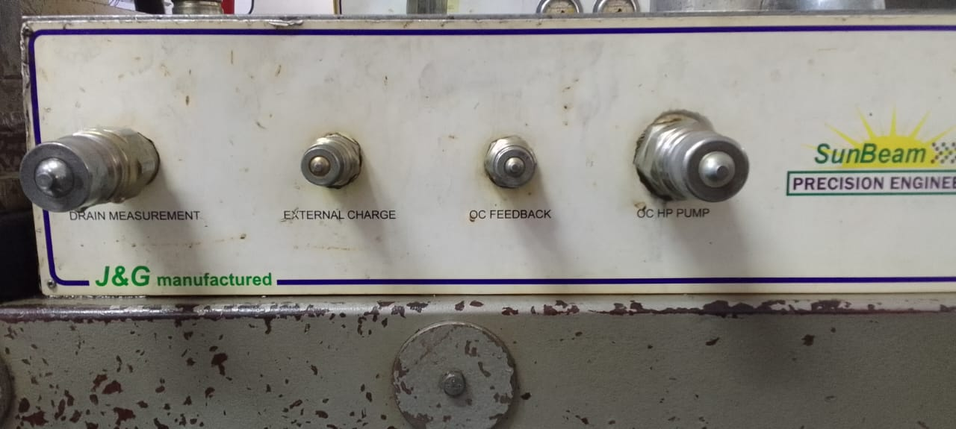
MODEL ID:- A10VO SIZE:- 18,28,45,71,100,140CC
Fit the hydraulic pump on the test bench
Connect all lines properly (Suction line, drain line, OC HP PUMP Line, OC feedback line)
Note:- The lines responsible for open circuit are marked above.

Slide 4
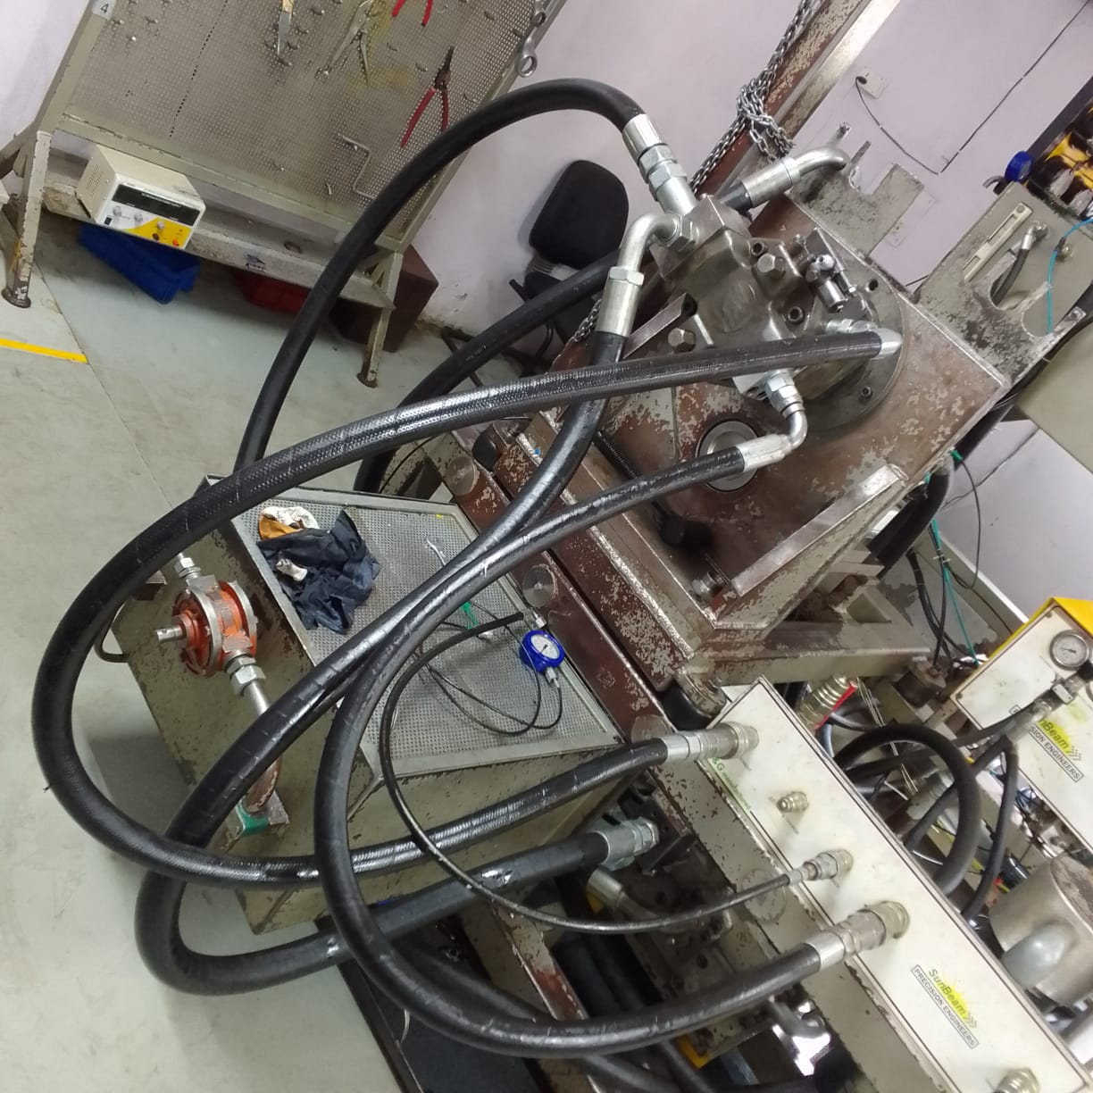
Connection of all lines of the pump during air release from the pump.

Slide 5
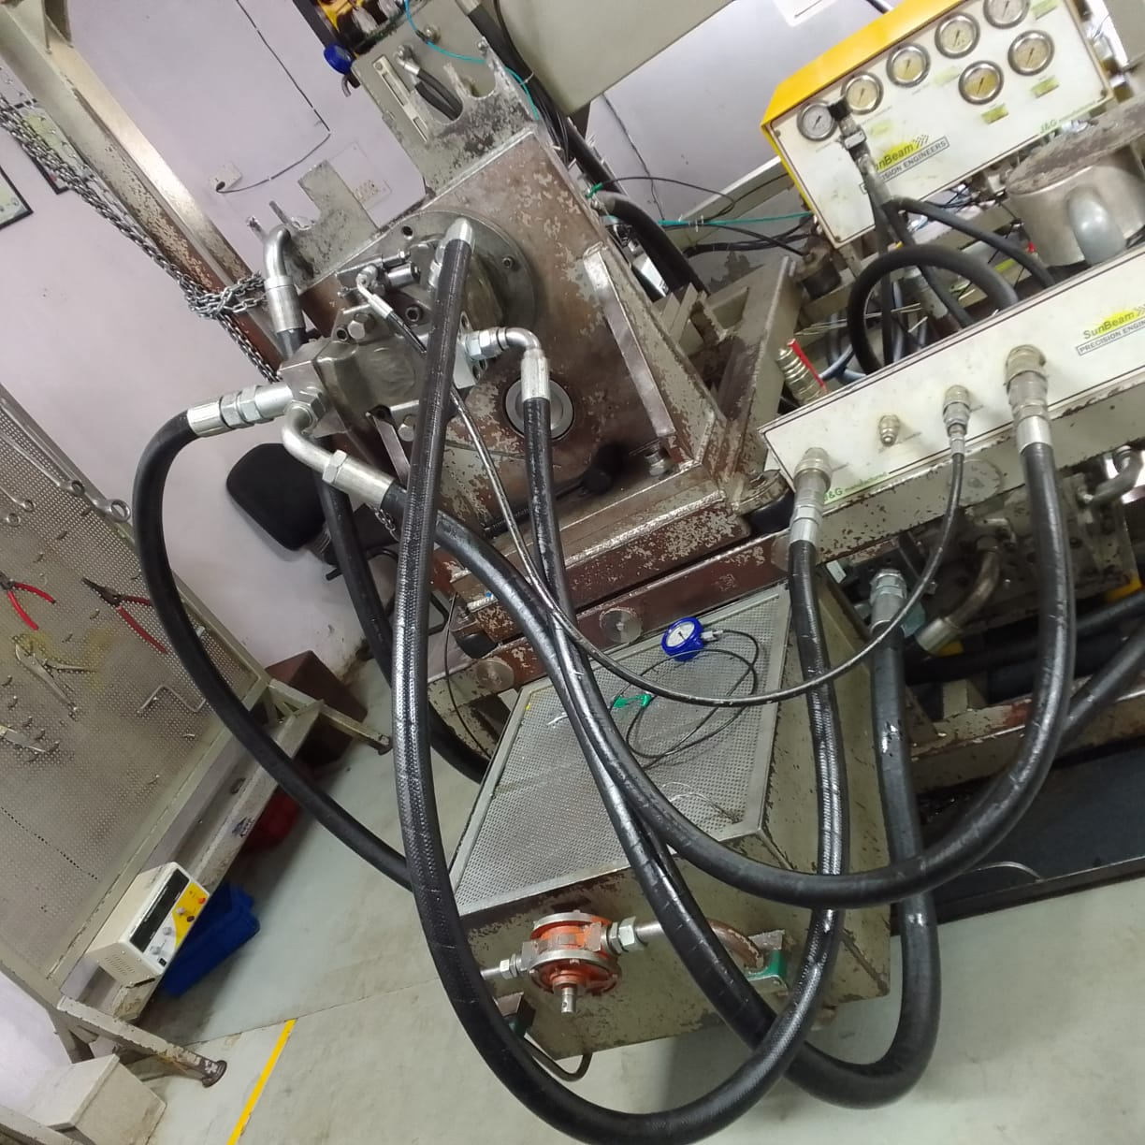

Slide 6
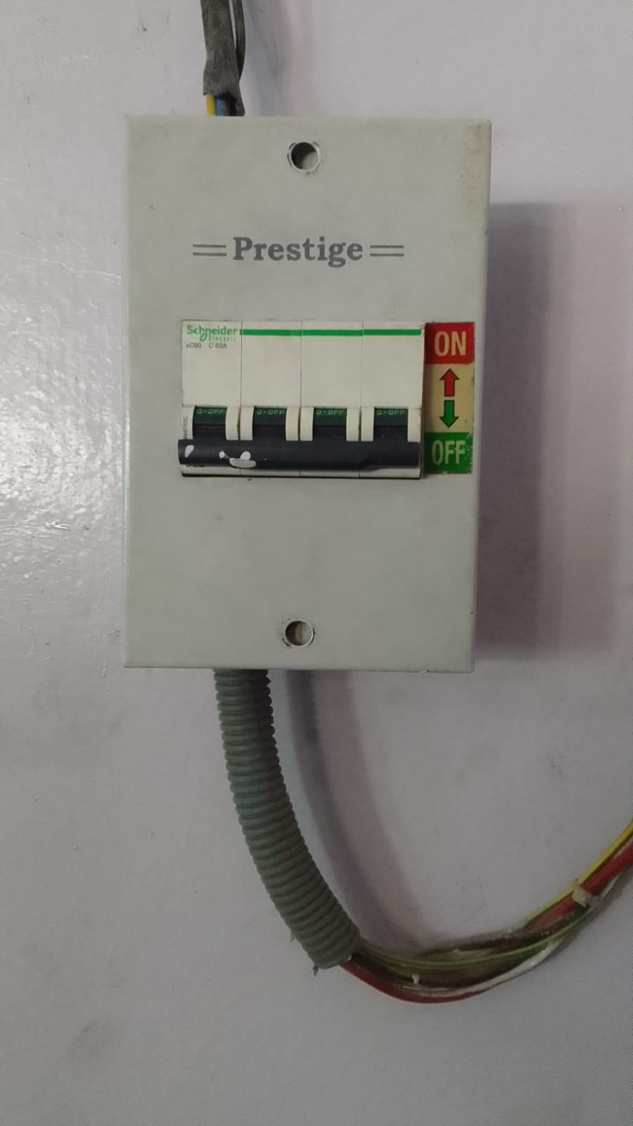
STANDARD OPERATING PROCEDURE
Main power MCB - ON/OFF
ON
OFF

Slide 7
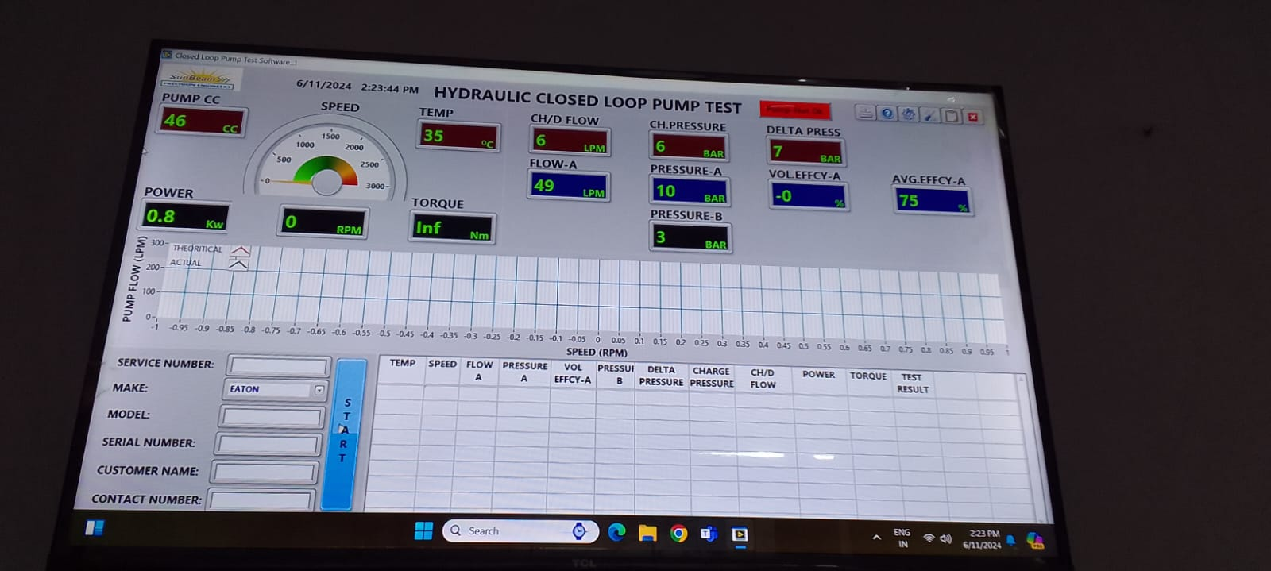
STANDARD OPERATING PROCEDURE
Fill the data in the software and select the required data in the panel.

Slide 8
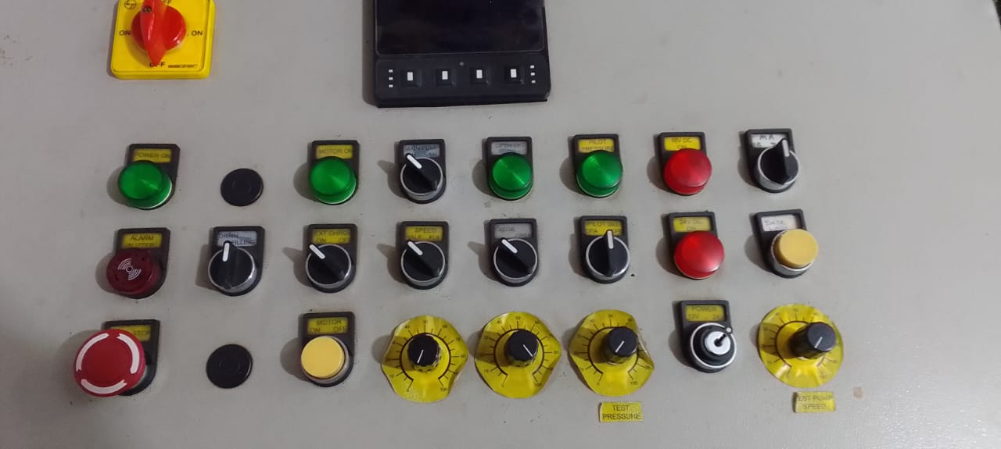
STANDARD OPERATING PROCEDURE
LOOP SELECTION SWITCH CLOSE/OPEN
DIRECTION SELECTION SWITCH RH/LH
INCREASE RPM SWITCH

Slide 9
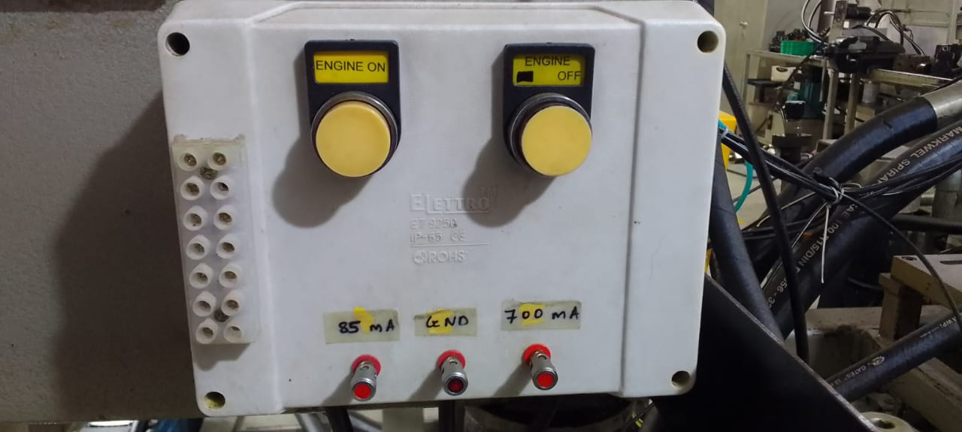
STANDARD OPERATING PROCEDURE
After this, start the engine and gradually increase the RPM to 1000.

Slide 10
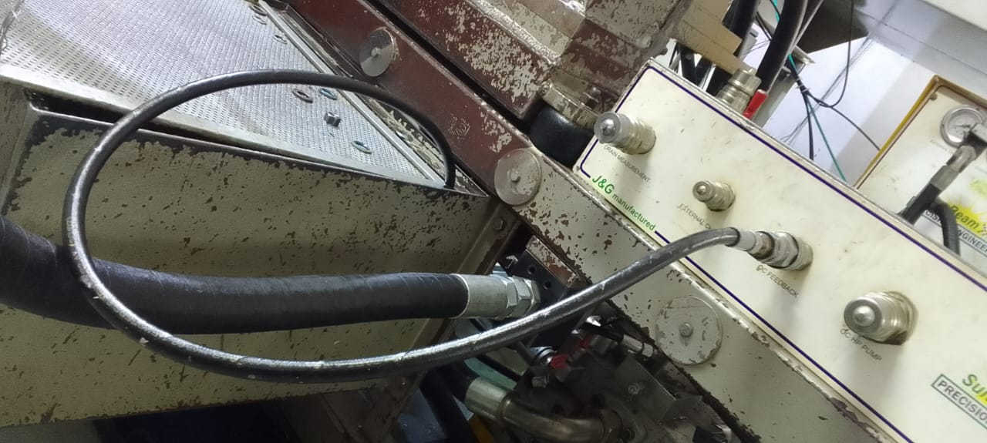
STANDARD OPERATING PROCEDURE
Before testing, increase pump speed and release air from the pump and Tank connect to feedback line during this time.
Check the load sensing pressure and set its pressure if necessary.
OC feedback line

Slide 11
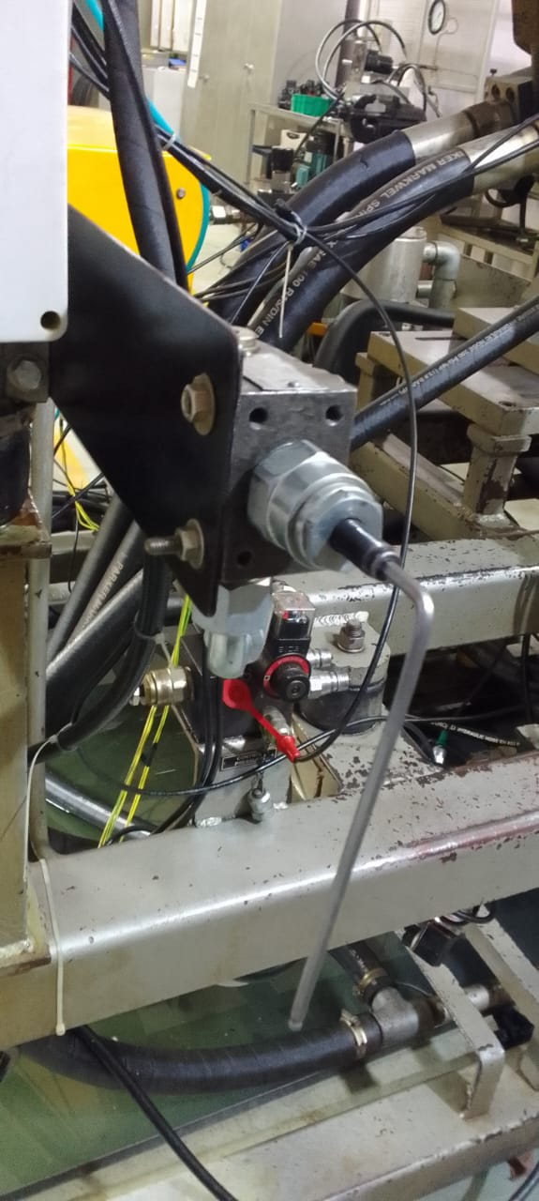
STANDARD OPERATING PROCEDURE
The pressure of load sensing and pressure compensator is checked by applying load.

Slide 12
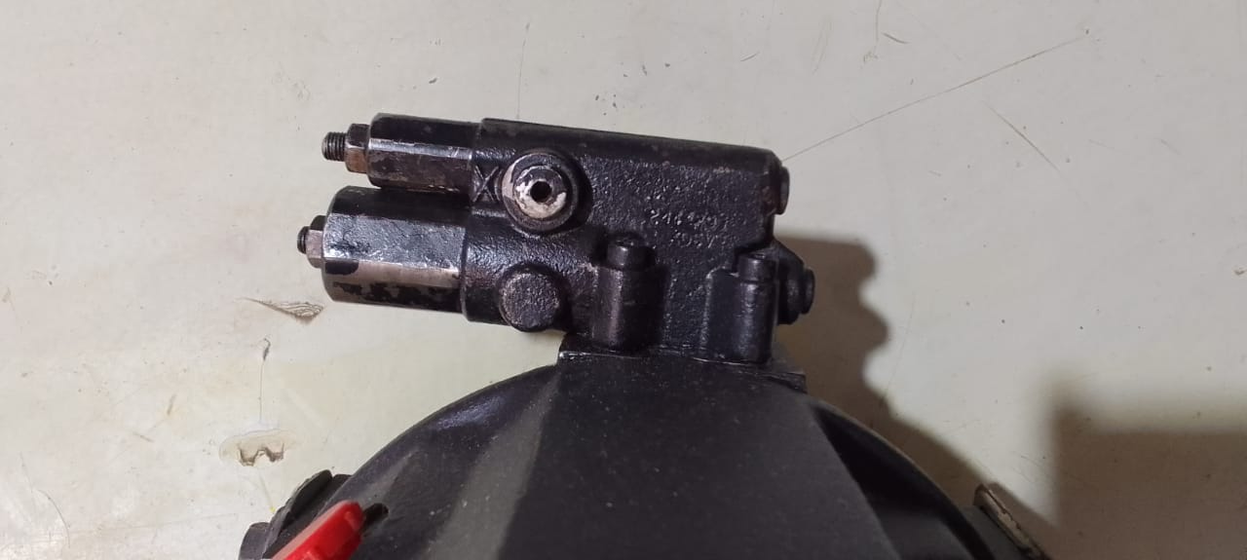
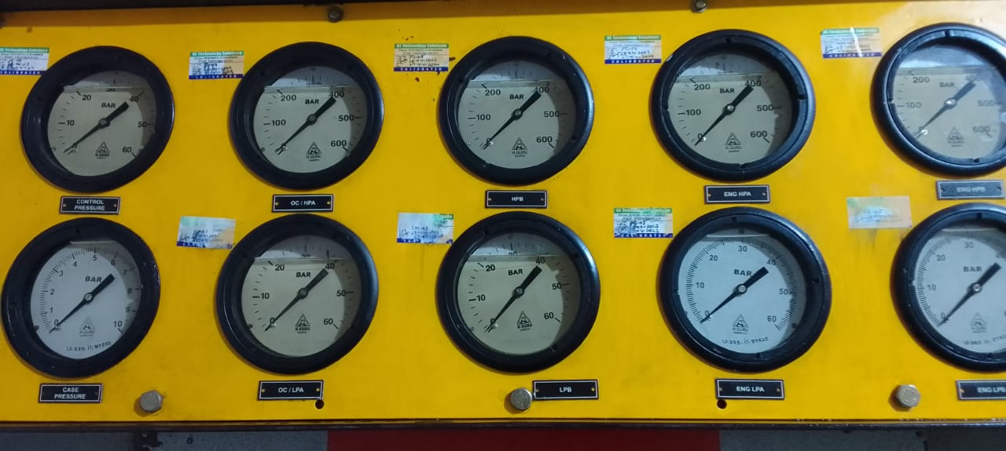
STANDARD OPERATING PROCEDURE
Load sensing setting
Pressure compensator setting(main pressure)
LS Connection line
PC (Main pressure)
LS (load sensing)

Slide 13
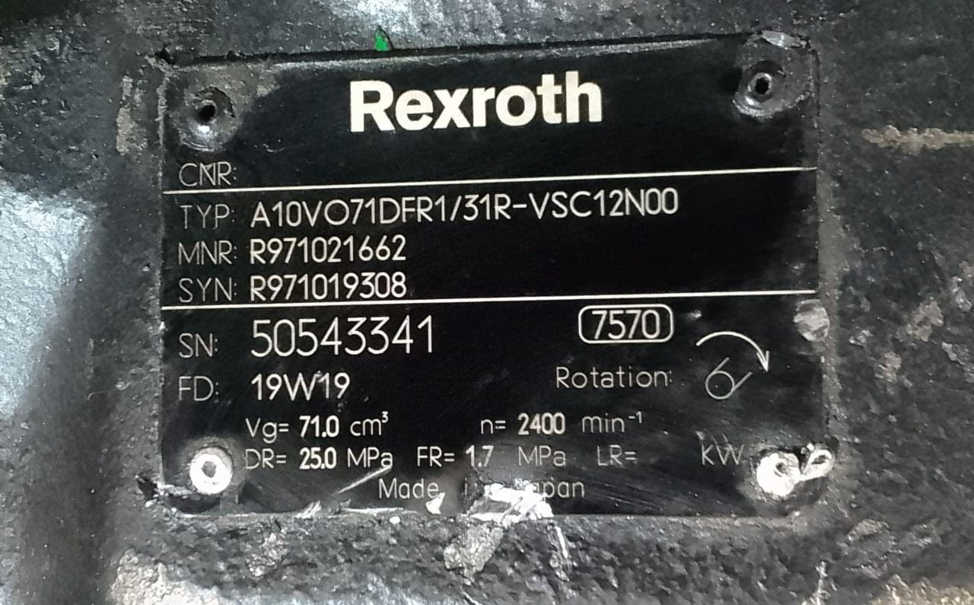
STANDARD OPERATING PROCEDURE
Check the Pressure compensator pressure and set its pressure if necessary.
Whatever pressure we set, we do it according to the name plate.
For example:-
PC Setting – 250bar
LS Setting- 17bar

Slide 14
STANDARD OPERATING PROCEDURE
Checking point in this model pumps:-
Pump Flow
LS pressure
Main pressure
Return flow
External leakage

Slide 15
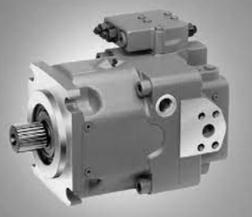
MODEL ID:- A11VO SIZE:- 40,60,75,95,130,145,190,260
HYDRAULIC PUMP OPEN CIRCUIT

Slide 16
STANDARD OPERATING PROCEDURE
Fit the hydraulic pump on the test bench
Connect all lines properly (Suction line, drain line, OC HP PUMP Line, OC feedback line)
Note:- The lines responsible for open circuit are marked above.

Slide 17
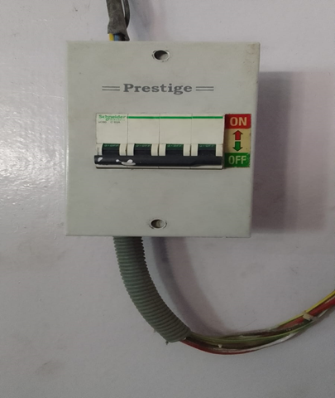
STANDARD OPERATING PROCEDURE
Main power MCB - ON/OFF
ON
OFF

Slide 18
STANDARD OPERATING PROCEDURE
Fill the data in the software and select the required data in the panel.

Slide 19

STANDARD OPERATING PROCEDURE
EMERGENCY SWITCH
INCREASE RPM SWITCH
PANEL ON/OFF SWITCH
LOOP SELECTION SWITCH OPEN/CLOSE
DIRECTION SELECTION SWITCH RH/LH

Slide 20
STANDARD OPERATING PROCEDURE
After this, start the engine and gradually increase the RPM to 1000.

Slide 21
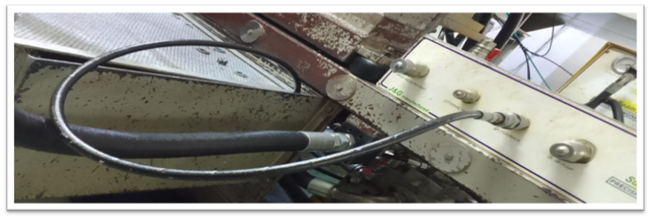
STANDARD OPERATING PROCEDURE
Before testing, increase pump speed and release air from the pump and Tank connect to feedback line during this time.
Check the load sensing pressure and set its pressure if necessary.
OC FEEDBACK LINE

Slide 22
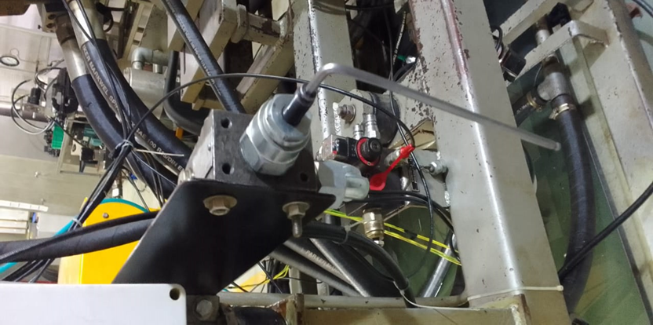
STANDARD OPERATING PROCEDURE
The pressure of load sensing and pressure compensator is checked by applying load.

Slide 23
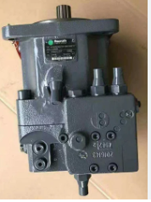
STANDARD OPERATING PROCEDURE
LS Connection line
Torque setting
Load sensing setting
Pressure compensator setting(main pressure)
TORQUE ENGINE LOAD
PC (Main pressure)
LS (load sensing)

Slide 24
STANDARD OPERATING PROCEDURE
Check the Pressure compensator pressure and set its pressure if necessary.
Whatever pressure we set, we do it according to the name plate.
For example:-

Slide 25
STANDARD OPERATING PROCEDURE
Checking point in this model pumps:-
Pump Flow
LS pressure
Main pressure
Torque (Engine load)
Return flow
External leakage

Slide 26
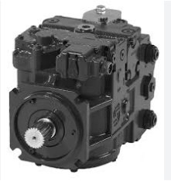
STANDARD OPERATING PROCEDURE
MODEL NO. :- 90 SERIES
SIZE:- 55,75,100,130,180,250
HYDRAULIC PUMP

Slide 27
STANDARD OPERATING PROCEDURE
First of all, mount the hydraulic pump on the Test bench and connect all lines (Suction ,A /B pressure line, tank line)properly.
Main power MCB - ON/OFF
ON
OFF

Slide 28
STANDARD OPERATING PROCEDURE
After that feed the data in software and select the data according to the pump in panel. For example:- select direction RH/LH, select loop Close ,Select extra charging ON/OFF

Slide 29
STANDARD OPERATING PROCEDURE

Slide 30

STANDARD OPERATING PROCEDURE
After this, start the engine and gradually increase the RPM to 1000.

Slide 31
STANDARD OPERATING PROCEDURE
Before testing, increase pump speed and release air from the pump and gauge capillary connect to charging pressure checking point during this time.

Slide 32
STANDARD OPERATING PROCEDURE

